Slide 1

Instructor Kick-off
Analyze A/B Test Results
© 2019 Udacity. All rights reserved.

Slide 2
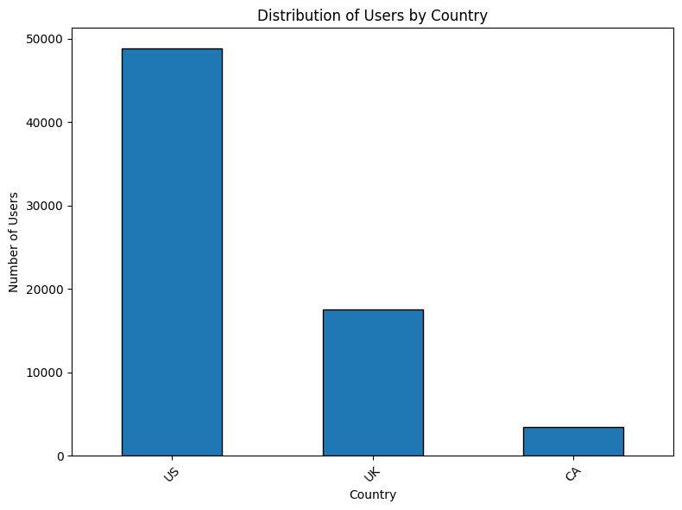
How Was The Experiment Implemented?​
Total Variant Visitors: 35211
Total Control Participants:​ 34678

Slide 3
Conversion Rates
 | U.S. | U.K. | CA
Control | 10.7% | 10.16% | 9.45%
Treatment | 15.8% | 14.87% | 15.40%
Executive Summary: The probabilities suggest that the Treatment group consistently has higher conversion rates across all countries than the Control group, indicating the treatment is associated with improved conversions. However, the differences in conversion rates between countries within each group are minor, suggesting that the Country does not have a meaningful impact on conversion rates. This implies that the treatment's effectiveness is consistent regardless of the user's country.

Slide 4
Experiment Results
Treatment Conversion Rate: 15.53%
Control Conversion Rate:​ 10.53%
Delta in Treatment vs. Control Conversion Rate:​ 5.01%
p-value:​ 0.00
Conclusion:​
Compare the p-value to the significance level (𝛼=0.05):
If 𝑝≤0.05, there is statistically significant evidence of a difference in conversion rates.
Otherwise, there is no statistically significant evidence.

Slide 5
Country Results
Conclusion: There are no statistically significant differences in conversion rates between countries, as indicated by the high p-values for the US and UK coefficients in the logistic regression model. This suggests that the country does not have a meaningful impact on conversion rates.

